Slide 1
Use of AI in Operational Technology Networks and packet-based attacks detection
Zoltán Dobrády, Szilárd László Takács, Timót Hidvegi
Notes:
I would like to extend my warmest welcome to all and express my sincere gratitude for your presence. Our topic is Use of AI in Operational Technology Networks and packet-based attacks detection.

Slide 2

ABOUT US
The name of our research team:
„Industrial and Research Lab for Cybersecurity”
Domain:
https://cyberseclab.eu/
Research area:
Artificial intelligence applied to automotive and industrial systems.
Notes:
Our Ph.D. team principally engages in research endeavors at Széchenyi István University.
I would like to introduce our team members to you.
First Head of Team is Dr. Timot Hidvegi PhD. He is an associate professor at our University and IT security expert.
The second member of our Team would be Szilard Laszlo Takacs PhD. student.
The last member is me, My name is Zoltan Dobrady also PhD student. Currently I work as a software developer at Swarco Limited at Vienna
The current project is in line with our main research objectives.
Our primary focus lies on cybersecurity, which we aim to enhance through the utilization of artificial intelligence.

Slide 3
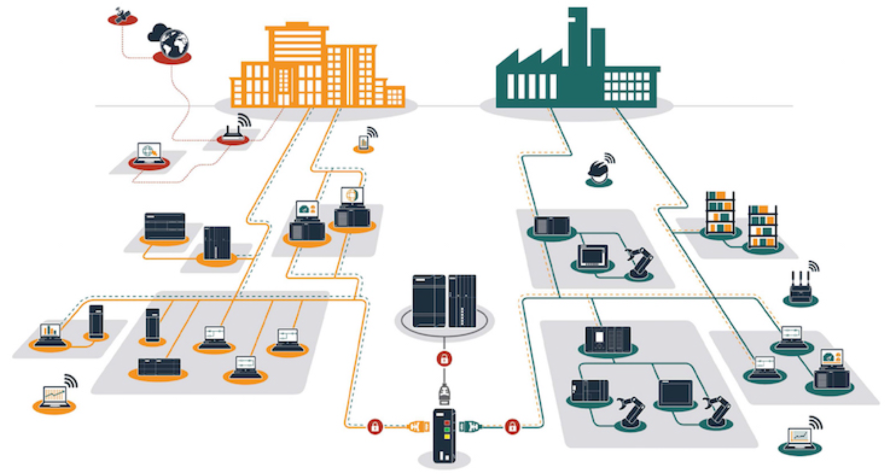
Network OVERVIEW
IT NETWORK
OT NETWORK
An OT (Operational Technology) network refers to a specific type of network used in industrial and critical infrastructure environments.
This is the communication between the machine (PLC) units
Includes communication of peripherals (e.g. ProfiNET, ProfiBUS, ect.) to the machine
Our research analyses data packets on this network
Source: inprosec
Notes:
Before we commence, it would be beneficial for everyone to possess a common understanding of what OT networks are.
As you can see on the picture on the right-side is an OT network. It is a network connection that connects production devices such as robots, transfer bands, pumps, packaging machines, and other similar devices. The machines are usually controlled by PLC-s and they use this network to communicate with each other.
The picture on the left shows an example of an IT network. The main difference between the two is that IT networks are primarily local area networks and typically include personal computers, laptops, and server equipment. Neither modbus nor CAN bus protocols are used, and there is no PLC communication presence on the network.

Slide 4
PROBLEM
Vulnerability
OT systems or networks may be susceptible to targeted cyberattacks Contrary to IT systems, these peripherals are not intended to ward off cyberattacks
Production downtime
Current example: Recently one big car manufacture acknowledged to suffer a targeted cyberattack witch caused the complete stop off production lines across Europe.
Defective product manufacturing
Even one manipulated data packet is enough to cause a peripheral to malfunction. This leads to the production of defective products, which causes a lot of financial costs.
Data packet analysis
Currently this data packet analysis is done manually after the attack with filtering methods(e.g. wireshark, tshark, ect.) which poses an additional error source, and it takes a great deal of time
Notes:
As you are aware from your personal experiences, it is imperative to note that any component that is connected to a network is also susceptible to vulnerability. What is the meaning of 'vulnerable?? It can be attacked by someone outside of the organization. Unlike IT systems, these systems were not specifically designed to safeguard against cyberattacks. This is a main problem.
The second problem as we know recently, a prominent automobile manufacturer acknowledged the occurrence of a targeted cyberattack that resulted in the complete stop of production lines across Europe. Is yust happend two weeks ago.
During my work on machine development, I have firsthand knowledge of the potential complications and danger that can arise when sending incorrect data packets to the peripherals. When someone maliciously sends manipulated data packets, the same thing happens.
Data packets that are travelling on the ot network are currently analysed manualy. This is done by humans, and the analysis is only done after the attack has already happened.

Slide 5
Possible SOLUTION
„Real time” analysis
Use of Artificial intelligent
It is imperative that the packets are analyzed in real time, rather than after the attack has occurred.
After selecting the appropriate learning method for the A.I., packet analysis can be used to predict attacks
Notes:
We will require a real-time data packet analysis in order to mitigate the threat. In this study, we attempted to employ artificial intelligence (AI) to identify unusual requests. By that, I mean requests that are not usual, or anything that is considered out of the ordinary

Slide 6
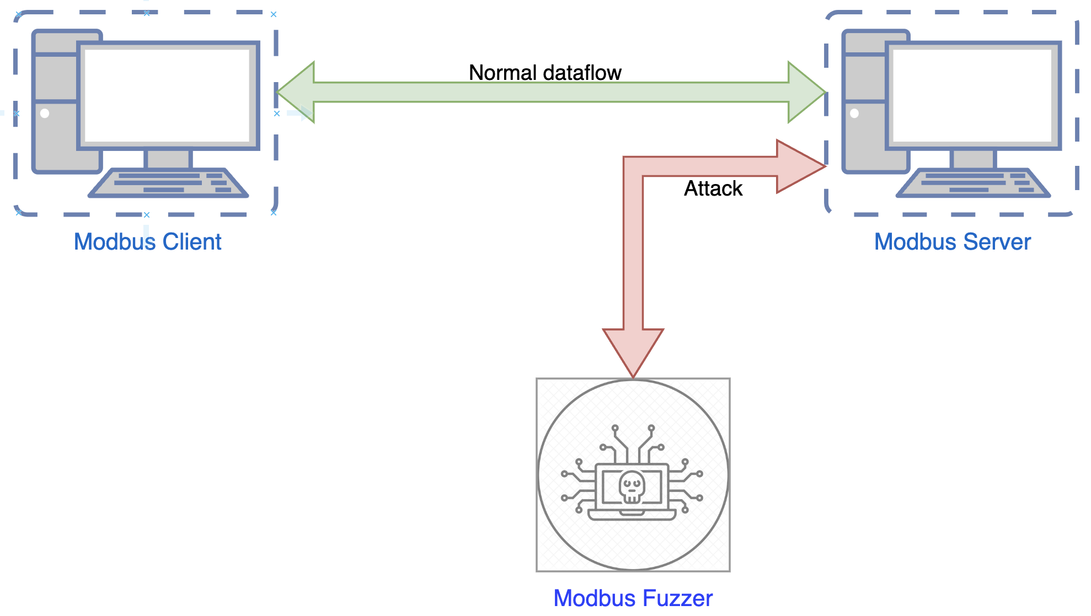

Attacking Mechanism
Flooding the data stream with large amounts of data
In response the server is left with little or no resource for communication to the client
Notes:
The attack mechanism used essentially floods the Modbus server with a large amount of data, resulting in little to no resources left for the communication on the Client side.
The impact of this suboptimal execution on the environment is that the peripherals controlled by the Client slow down or stop altogether.
We monitored the system processes during the attack mechanism using the network packet analyser software called Wireshark, and the data streams were archived for each peripheral.

Slide 7
Virtual testing environment
Used three virtual machines
Standard Modbus Server/Client communication
Using a fuzzer, we executed a cyber attack by generating continuous requests across the network
Fuzzer: generally used for examining and testing applications/protocols.
Notes:
We used three virtual machines with standard Modbus Server/Client communication. A fuzzer was used in addition between the two devices. So, the third virtual machine was allocated to the fuzzer. Fuzzers are generally used for examining and testing applications/protocols. Fuzzers can be used to discover vulnerabilities and weaknesses in applications, making the implementation process easier. Therefore, signs of fuzzer usage should be monitored in an industrial network.

Slide 8
A.I.
Artificial Intelligence, refers to the simulation of human intelligence in machines that are programmed to think and learn like humans.
We used lot of A.I. methods:
Statistical learning
Natural Language processing
2023
Notes:
It is a branch of computer science that aims to create smart machines capable of performing tasks that typically require human intelligence, such as visual perception, speech recognition, decision-making, and language translation. We used ai for data packet analysis,.
We used two methods: Statistical learning, and Natural Language processing.

Slide 9
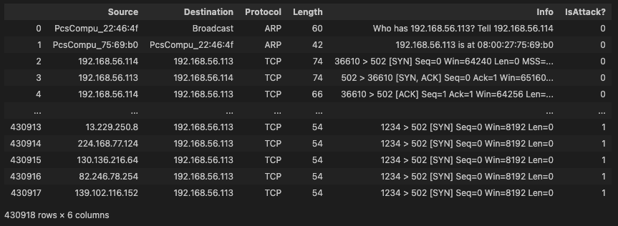
Preparing generated DATA for A.I.
Before:
The generated data packets had to be labelled
Irrelevant columns for the A.I. have been removed.
For the natural learning model we used word-based tokenization on the dataset.
After:
Data |  |  |  | IsAttack?
Source IP | Destination IP | Protocol | Length | (0 = No attack,1 = Attack)
210.11.140.185 | 192.168.56.113 | TCP | 54 | 1
14.221.153.215 | 192.168.56.113 | TCP | 54 | 1
176.137.215.247 | 192.168.56.113 | TCP | 54 | 1
88.64.227.9 192 | 192.168.56.113 | TCP | 60 | 0
3.156.6.135 192 | 192.168.56.113 | TCP | 60 | 0
Notes:
First we needed to preare data for traing the A.I.
After the virtual network was created, we wrote the softwares for the communication betwen the server, the client, and the fuzzer.
This generated the needed data packets wich we used to train the AI.
The generated data packets had to be labelled
Irrelevant columns for the A.I. have been removed.
For the naturel learning mode we used word-based tokenization on the dataset.
For the neurel network tokenization was not needed
On the picture you can se the edited data, on the top is the before, and on the buttom is after the edit.

Slide 10
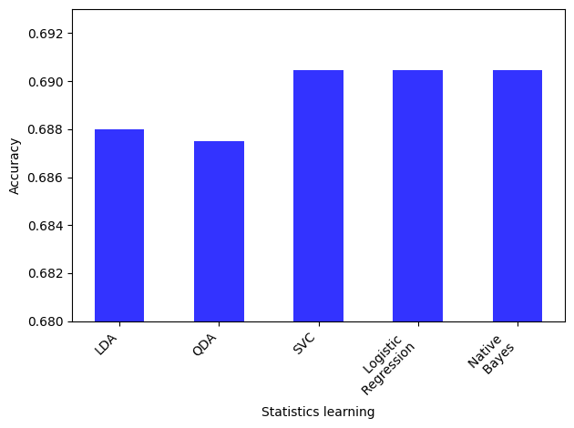
statistical learning mode results
Models | Accuracy score
Linear regression | 0.443869
Logistic regression | 69.04627
kNN(k Nearest Neighbors) | 31.23024
Linear Discriminant Analysis | 68.80032
Quadratic Discriminant Analysis | 68.75143
Support Vector Machine | 69.04627
Naive Bayes | 69.04627
Random Forest | 46.13880
The models:
refer to algorithms and architectures designed to perform specific tasks or solve particular problems.
These models are created through machine learning techniQues
trained on large datasets to recognize patterns and make predictions
accuracy score:
refers to a metric used to measure the performance of a classification algorithm
Notes:
This slide shows the results of the statistical learning model. Kindly take note that we utilized multiple statistical models for testing purposes, as evident from the above. The table's top-left corner displays the various statistical models we employed, and the right side displays the accuracy scores. Furthermore, it is important to note that the accuracy scores of the various statistical models exhibit significant variances. Upon completion of the cross validation, the most effective models were Logistic regression and Support Vector Machine

Slide 11
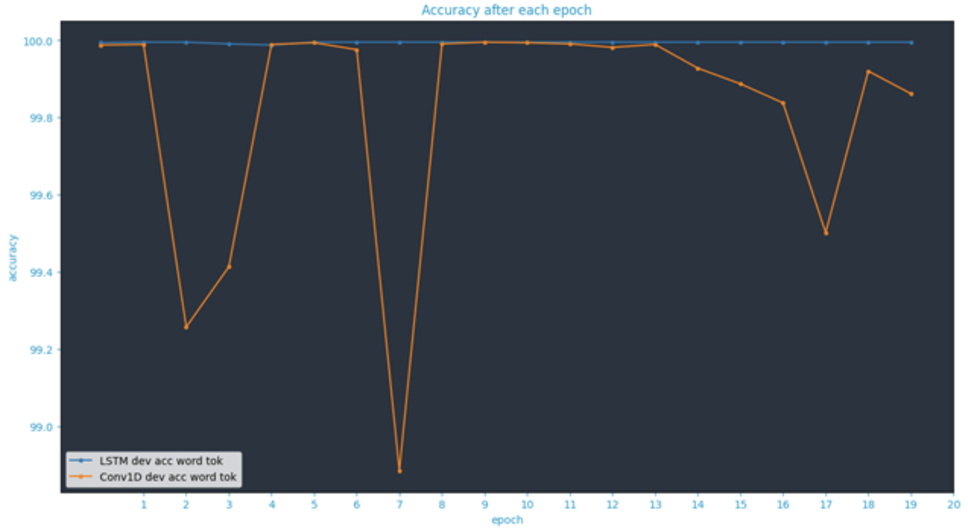
NATUREL learning mode results
Two models were used:
LSTM,
1D Convolution method.
The models were trained over 20 epochs.
neural network.
the results suggests that the system may be overfitted
Notes:
As previously mentioned on the slide, here we have implemented the word-based tokenization on the dataset. We tested two naturel learning models, LSTM and 1D Convolution. These methods are no longer statistical learning models, they are called neural networks. We trained the models for over 20 epochs. We may have overfitted the systems, as you can see from the results. The data suggests that the system operates with an accuracy of over 99 percent; however, our experience tells us, that this is not feasible.

Slide 12
Conclusion
Machine learning could be a possibble solution for detecting attacks.
The Support Vector Machine, Naive Bayes, Logistic Regression yielded the most superior outcomes among all statistical learning models.
Statistical learning algorithms alone may not be accurate enough to detect attacks, but in combination with other algorithms, they can improve protection and optimize attack identification.
Data packet detection in neural networks needs more research
Cyber security is an important issue that we need to improve.
Notes:
Finally, we have reached the conclusion page. Our investigation suggests that machine learning could offer a means of detecting cyberattacks. After conducting a thorough evaluation of various statistical learning techniques, it was determined that the Support Vector Machine, Naive Bayes, Logistic Regression, exhibited the highest level of accuracy, averaging approximately 70 percent. Statistical learning algorithms may not possess sufficient accuracy to detect attacks on their own; however, when utilized in conjunction with other algorithms, they can enhance protection and enhance attack identification. The detection of data packets in neural networks requires substantial research to test and validate its performance in diverse environments. The final and most significant point is that cybersecurity is a significant concern that requires continual enhancement.

Slide 13
THANK YOU
Zoltán Dobrády
zoltan.dobrady@hotmail.com
Szilárd László Takács
szhilank@gmail.com
Timót Hidvégi
timot.hidvegi@cyberseclab.eu
Notes:
Thank you for your time.I appreciate the opportunity to speak with you today.I’ll now answer any questions you have about (topic).If you need any further information, feel free to contact me at (contact information).

